Slide 1
Be at least 8-10 min. long
Describe the core message or hypothesis for your project.
Describe the questions you and your group found interesting, and what motivated you to answer them
Summarize where and how you found the data you used to answer these questions
Describe the data exploration and cleanup process (accompanied by your Jupyter Notebook)
Describe the analysis process (accompanied by your Jupyter Notebook)
Summarize your conclusions. This should include a numerical summary (i.e., what data did your analysis yield), as well as visualizations of that summary (plots of the final analysis data)
Discuss the implications of your findings. This is where you get to have an open-ended discussion about what your findings "mean".
Tell a good story! Storytelling through data analysis is no different than in literature. Find your narrative and use your analysis and visualization skills to highlight conflict and resolution in your data.
Presentation Guidelines
You are free to structure your presentations to your liking, but students tend to have success with the following format.

Slide 2


The Impact of Behavioral Traits of Gen X and Millennials on Obesity.
Dan K, Darlene B, Darlene K,
Taylor R.

Slide 3
Motivation & Summary Slide (Darlene B)
Define the core message or hypothesis of your project.
Describe the questions you asked, and why you asked them
Describe whether you were able to answer these questions to your satisfaction, and briefly summarize your findings

Slide 4
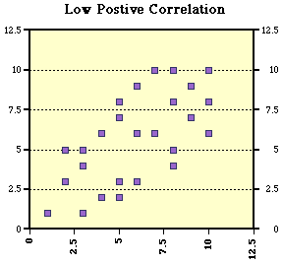
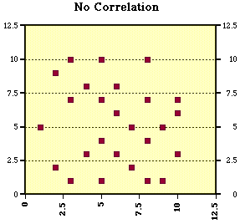
Is there a relationship between obesity and physical activity?
H1 – There is a relationship
H0 – There is no relationship.

Slide 5
Questions & Data
Elaborate on the questions you asked, describing what kinds of data you needed to answer them, and where you found it

Slide 6
Questions & Data
Question: How does diet and exercise contribute to rates of obesity in Millennials and Gen X?
Scope Summary: our analysis will examine the relationship between nutritional and lifestyle behaviors (diet, exercise, etc..) and the rates of obesity between Millennials and Gen X.

Slide 7



What kinds of data was needed? Where did we find it
BRFSS - The Behavioral Risk Factor Surveillance System is the nation’s premier system of health-related telephone surveys that collect state data about U.S. residents regarding their health-related risk behaviors, chronic health conditions, and use of preventive services.
NHANES - The National Health and Nutrition Examination Survey is a program of studies designed to assess the health and nutritional status of adults and children in the United States. The survey is unique in that it combines interviews and physical examinations.

Slide 8
Data Cleanup & Exploration (Taylor)
Describe the exploration and cleanup process
Discuss insights you had while exploring the data that you didn't anticipate
Discuss any problems that arose after exploring the data, and how you resolved them
Present and discuss interesting figures developed during exploration, ideally with the help of Jupyter Notebook

Slide 9
Data Analysis (all)
Discuss the steps you took to analyze the data and answer each question you asked in your proposal
Present and discuss interesting figures developed during analysis, ideally with the help of Jupyter Notebook

Slide 12
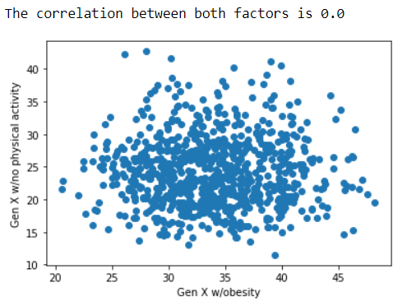
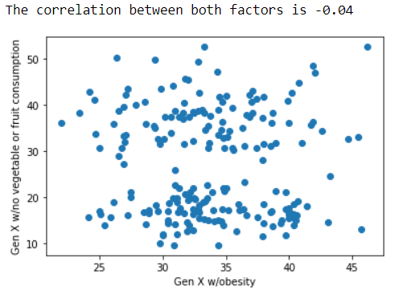
Generation X
Pearson correlation coefficient between ‘Being Obese’ and ‘No physical activity’
Pearson correlation coefficient between ‘Being Obese’ and ‘No vegetable or fruit consumption’

Slide 13
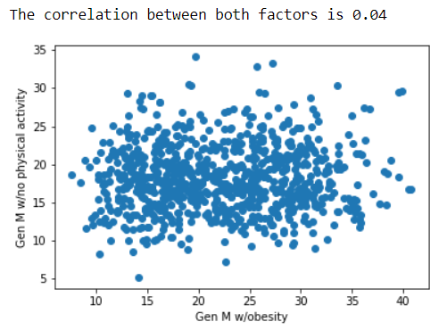
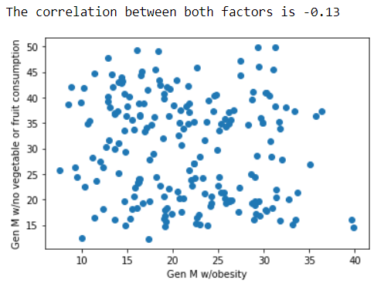
Millennials
Pearson correlation coefficient between ‘Being Obese’ and ‘No physical activity’
Pearson correlation coefficient between ‘Being Obese’ and ‘No vegetable or fruit consumption’

Slide 14
Discussion (all)
Discuss your findings. Did you find what you expected to find? If not, why not? What inferences or general conclusions can you draw from your analysis?

Slide 15
Post Mortem (Darlene B)
Discuss any difficulties that arose, and how you dealt with them
ValueError: x and y must have the same length.
Deleting a ‘(‘
Re-running constantly
Discuss any additional questions that came up, but which you didn't have time to answer: What would you research next, if you had two more weeks?

Slide 16
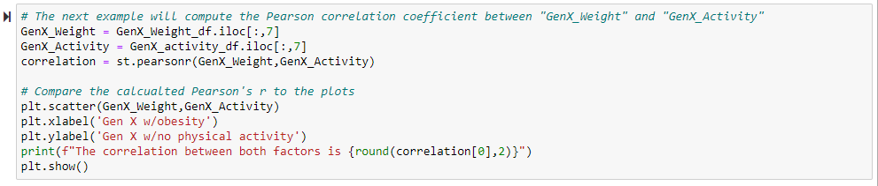
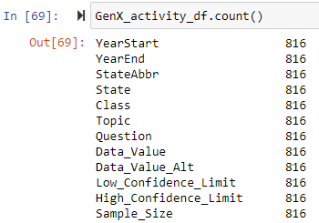
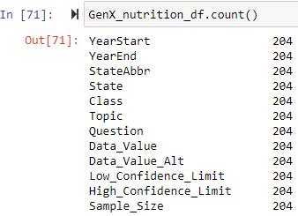
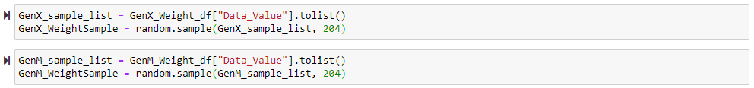
ValueError: x and y must have the same length.

Slide 17
Questions?
Open-floor Q&A with the audience

Slide 18
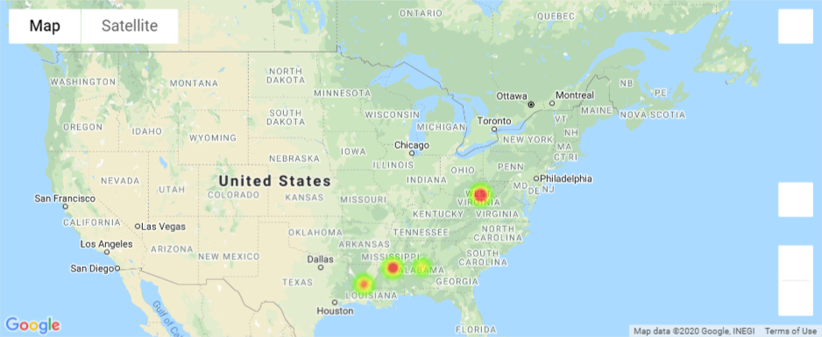
Top10 Obesity

